Slide 1

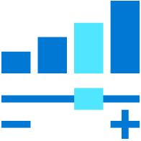
Azure Data Explorer
Ralph Kemperdick, Microsoft
Christoph Seck, KI-Group
Cloud Solution Architect
28-06-2022

Slide 2
Agenda
Getting started aka.ms/kustofree
Import Options & external tables, KQL, Functions
Visualize
Azure Data Explorer Dashboards
Power BI
Caching, Config, Time Series
Architecture Options, IOT & Spark
ADE, ML

Slide 3



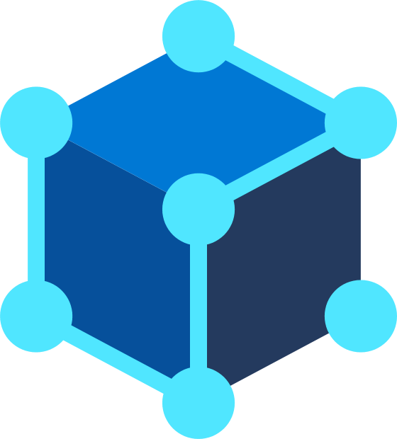
Digital Transformation
Engage
customers
Empower
people
Intelligent
Creates innovative ways to stay connected and relevant
Systems & Experiences
Data & AI
Optimize
operations
Transform
products
Notes:
We’ve all seen many organizations undergo digital transformation at breakneck speeds– many have been racing forward and achieved years of transformation in just a few months.
Companies who are focused on digital transformation are the fastest to adapt. They’re creating innovative ways to stay connected and relevant in the changing world. They’re reshaping our idea of business norms.
We often hear from customers, how do we become a data driven company? ​
What products do we need to transform our business?​
How do we create more value, prioritize to save cost? ​
This is where our team comes in to serve our customer, and help them with digital transformation in these four areas: ​
Empower people ​
Transform products​
Optimize operations​
Engage customers​
At the center of this we provide intelligent systems and experiences based on data and ai to power transformation.​
In our day and age, the ultimate tool is data, and Telemetry data play a critical role.

Slide 4
Intelligent Cloud
50B
68
connected devices by 2030
Intelligent Cloud
175ZB
total amount of data by 2025
Intelligent Edge
Notes:
Talk about how we believe the programming model of intelligent devices and intelligent cloud/ intelligent engine is in data
Connected devices by 2030
175 ZB total amount of data by 2025
Digital transformation a key aspect this new programming, which spans the cloud and the edge. One of the key types of data that's really coming out in this new application paradigm is telemetry
Telemetry data is everywhere – we find it in IOT Sensors, logs, click streams – it drives advances in the connected devices we find in our homes, smart buildings, smart factories, and in devices that consumers and businesses rely upon.
Telemetry data is fueling digital transformation.
It’s generating terabytes and petabytes of data - every day.

Slide 5

Telemetry - A key data for Digital Transformation
IoT
Logs
Events
Time Series
Click Stream
Connected Devices
SIEM
Smart Buildings
Security
Smart Factories
Historians
Notes:
Telemetry data is everywhere – we find it in IOT Sensors, logs, click streams – it drives advances in the connected devices we find in our homes, smart buildings, smart factories, and in devices that consumers and businesses rely upon.
Telemetry data is fueling digital transformation.
It’s generating terabytes and petabytes of data - every day.

Slide 6
What are customers looking for?
Ways to break data silo
Get real time insights
Monitor health of systems, apps, devices…
Identify trends and anomalies
Perform root case analysis
Scale + Performance + Price
Notes:
Customer are looking at democratizing their data and explore it in near real time unconditionally. Enabling various scenarios like health monitoring of systems, apps, and devices, identifying trend and anomalies, and perform root cause analysis.
All this with a solution that can scale, is highly performant, and is economical.

Slide 7
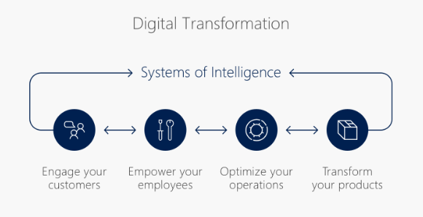

The Digital Transformation
“
digital feedback loops that help you better engage with your customers, empower your employees, optimize your operations, and reinvent products and business models
“
S. Nadella
https://www.linkedin.com/pulse/digital-transformation-satya-nadella/

Slide 8
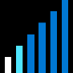


Big Data in Modern Business Environment
Free text data
Append Only
Click streams
Wikis, Blogs
Sensors/RFID/ Devices
Social Sentiment
Audio/Video
BigData
New decisions daily
Petabytes
Log files
Spatial & GPS coordinates
Data market feeds
eGov feeds
Weather
Text/image
Advertising
Mobile
Collaboration
eCommerce
Terabytes
Web 2.0
ERP/CRM
Web logs
Digital Marketing
Search Marketing
Recommendations
More decision makers
Gigabytes
Payables
Payroll
Inventory
Contacts
Deal Tracking
Sales Pipeline
Megabytes
Data Complexity: Velocity, Variety

Slide 9
Introducing Azure Data Explorer!
Any append-only stream of records
High volume
High velocity
High variance (structured, semi-structured, free-text)
Relational query model:
Filter, aggregate, join, calculated columns, …
Fully-managed
PaaS, Vanilla, Database
A big data analytics cloud platform optimized for interactive, ad-hoc queries
Purposely built
Rapid iterations to explore the data

Slide 10
Key pillars of Azure Data Explorer
INSTANT BIG DATA INSIGHTS
FULLY MANAGED PLATFORM
DEMOCRATIZING DATA ANALYTICS
PROVEN TECHNOLOGY TO SCALE FROM GBs PETABYTE
Notes:
Instant Big Data Insights ---Azure Data Explorer is a big data platform supporting near real time insights over data in petabyte scale
Fully Managed Platform - ADX is a fully managed platform for big data analytics. Embed Azure Data Explorer in SaaS applications to build multi-tenant or single tenant SaaS analytics solution for Time Series, Logs, Events, Transactions, and security data. No infrastructure management, no maintenance.
Democratizing Data Analytics - Azure Data Explorer democratizes self-service, big data analytics, with the intuitive Kusto Query Language (KQL) that provides the expressiveness and power of SQL with the simplicity of Excel
Proven Technology at Scale Petabyte - Azure Data Explorer is a distributed system with compute and storage that can scale independently, enabling analytics on gigabytes to petabytes of data.

Slide 11
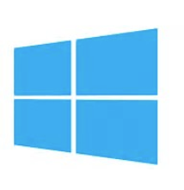
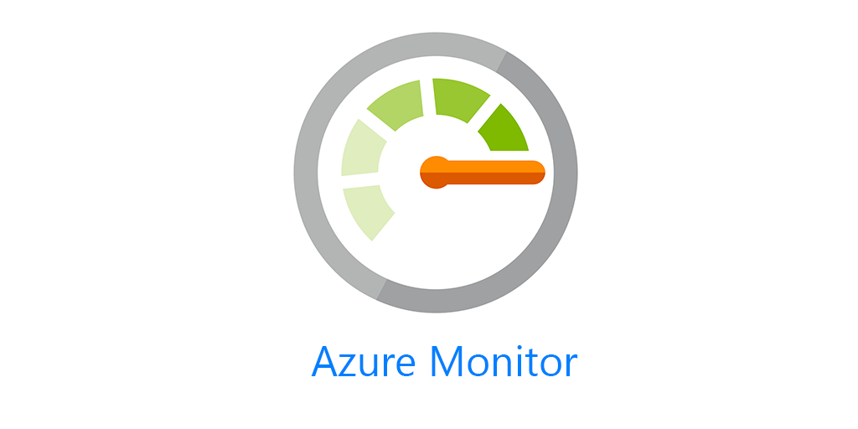







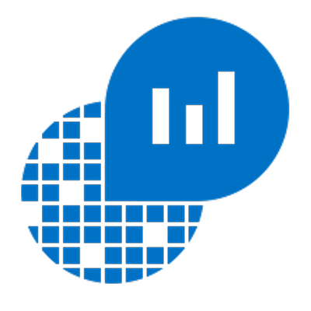


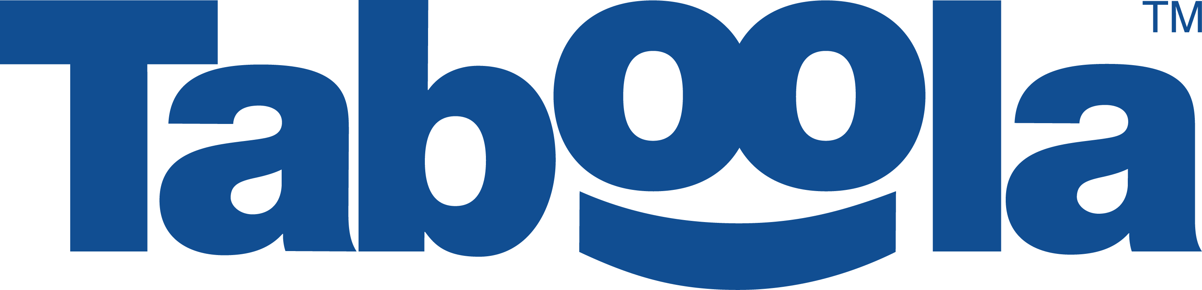
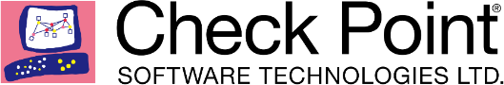
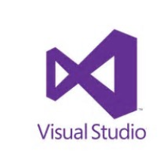
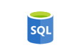


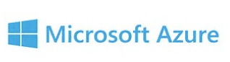
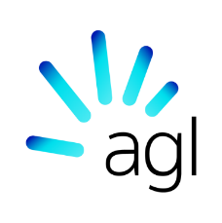



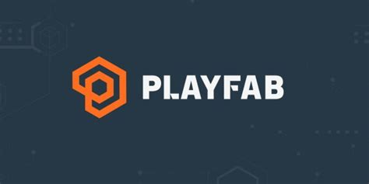
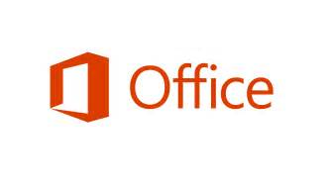


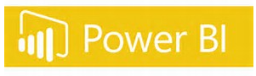

Proven Technology
In production since 2015 for internal Microsoft workload, GA since Feb 2019.
Battle tested for Microsoft internal workload
The platform for analytical solutions (SaaS)
Available as PaaS
Azure Monitor
Security Products
IoT
Gaming
#PoweredByADX
Notes:
Let me tell you about our journey with Azure Data Explorer.
To meet the growing demand of various Microsoft cloud services, Azure Data Explorer was home grown and launched back in 2015. Internally it’s called Kusto and used widely across Microsoft for telemetry analytics. It’s also the underline warm store for Azure Monitor, Application Insights, Azure Security Center, Time Series Insights, IoT Central, and more. All these services offers “a fit for purpose end to end solution”.
This is the same underline technology that we are offering to you as an Azure PaaS service.
© Microsoft Corporation

Slide 12

Microsoft’s Journey with Azure Data Explorer
65+ PB
Data ingested
daily
20+Billion
Queries per month
2+ Exabyte
Total Data Size
Azure Data Explorer A key to Microsoft's digital transformation journey
Notes:
Azure Data Explorer is a cornerstone for our operational analytics and is strategic to Microsoft. It has played a key role in Microsoft’s digital transformation journey operating at a massive scale, ingesting 35+ petabytes of telemetry data every day, 20+ billion queries per month, and 2+ Exabyte of data stored.

Slide 13
Common use cases across verticals
Retail
Financial
Oil/Gas & Energy
Security
Web Analytics, IoT Analytics
Audit Logs
Industrial IoT, Historian, Time Series, Grid analytics
Security Analytics, Threat Detection, SIEM
Healthcare
Advertising
Media Entertainment
Automotive
IoT device
Analytics
Personalized offers, campaign management
Content Delivery Network analytics, Viewer experience analytics, Live Event Analytics
Manufacturing, Connected cars, Fleet management
Central Observability (Logs, Traces, Metrics) and Time Series
Notes:
There are various Log and Time Series across the industries to:
Consolidate and correlate logs and events data across on-prem, cloud, 3rd party
Replace legacy log search solutions
Accelerate your AI Ops journey (pattern recognition, anomaly detection, forecasting, etc.)
Building IoT Analytics

Slide 14















Azure Data Explorer Customer Stories
Notes:
Here are “happy” customers they are using Azure Data Explorer today.
More customer stories at https://aka.ms/adx.stories

Slide 15
Customers are saying about Azure Data Explorer
“In terms of usability it is beyond compare any other database query language we have used so far.”
“The solution was so simple that we were up and running in a week, ingesting and analyzing 17 TB of data per day.”
Ariel Pisetzky
Vice President of IT
Emilian Ertel Senior Key Expert

Slide 16


Connected Trucks Connected Factories
Ingesting 9 trillion rows and 900+ terabytes of data!!!
Notes:
Daimler Trucks North America is an automotive industry manufacturer of commercial vehicles, they are using Azure Data Explore to power their digital transformation journey by building solutions around Connected Trucks and Connected Factories. Ingesting 9 trillion rows and 900+ terabytes of data!!!

Slide 17


Customer case study - Bosch
Leveraging Azure Data Explorer for powering Energy and Building Solutions
Notes:
BOSCH is leveraging Azure Data Explorer for powering their Energy and Building Solutions that they are offering to their customers.

Slide 18


Customer case study – Buhler Insights
Bühler Group enables intelligent manufacturing insights for a safer, greener tomorrow
With the help of the Bühler Insights platform and Microsoft Azure Data Explorer, Bühler’s customers are finding new ways to optimize their operations, reducing waste and energy usage, while increasing output.
Notes:
Microsoft Customer Story-Bühler Group enables intelligent manufacturing insights for a safer, greener tomorrow

Slide 19
Integration Patterns

Slide 20
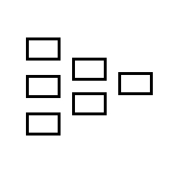

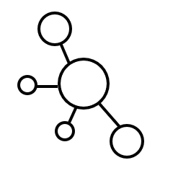
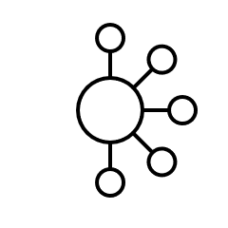
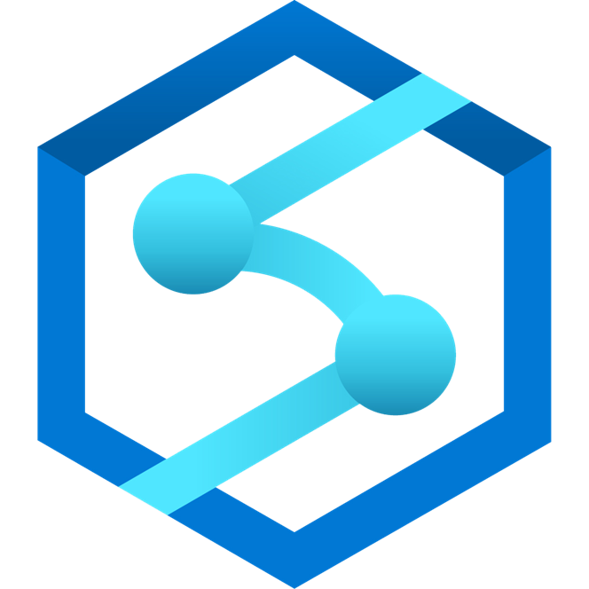
Integration: Streaming Ingestion
Land your data in ADX and then export to the data lake
Moving window of data (days to months)
Real-time, cached and indexed data for faster interactive query over billions of records
Logs (unstructured)
Streaming
Event Hub
Azure Data Explorer
Export to Data Lake
Media (unstructured)
Azure Data Lake Storage
IoT Hub
Files (unstructured)
Kafka
Business/custom apps
(structured)
Azure Data Factory
Azure Synapse Analytics
Azure Analysis Services
Power BI
Notes:
There are two typical patterns:
Streaming ingestion for low latency insights where the data directly lands into ADX, where its cached and indexed for faster query performance and optionally exported out to Azure Data Lake in parquet format ready for batch processing and integration with other Big Data and ML services.

Slide 21
Integration: Batch Ingestion
Ingest data from Data Lake or other sources in batch mode
Moving window of data (days to months)
Real-time, cached and indexed data for faster interactive query over billions of records
Logs (unstructured)
Event Hub
Azure Data Explorer
Ingest from Data Lakepa
Media (unstructured)
Azure Data Lake Storage
IoT Hub
Files (unstructured)
Kafka
Business/custom apps
(structured)
Azure Data Factory
Azure Synapse Analytics
Azure Analysis Services
Power BI
Notes:
You can also ingest data in batches to cache and index the data in ADX.

Slide 22
How it works

Slide 23
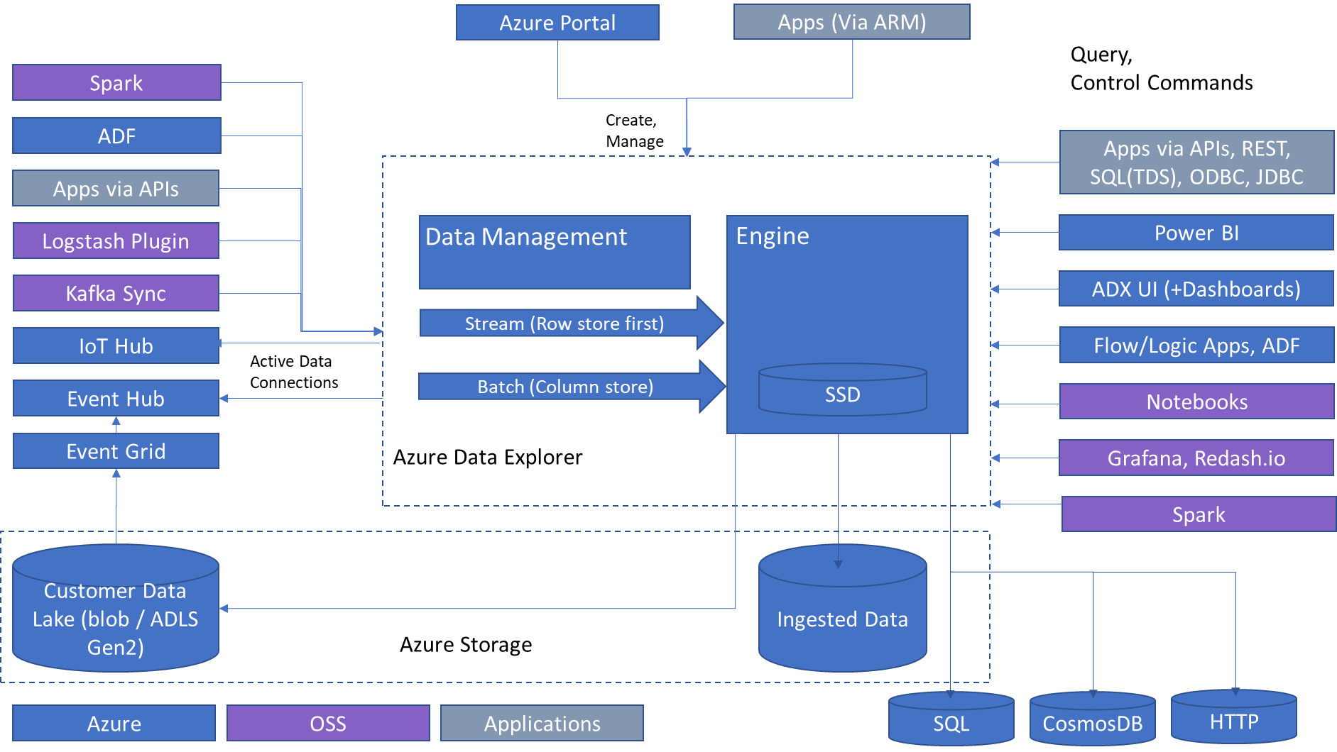
Architecture
Comprehensive Strength
Analytics Query language
Simple and powerful
High performance over large data sets
Granular resource utilization Control
Metrics and time-series data
Text search and text analytics
Multi-dimensional/relational analysis
Publicly available
Data Exploration
Scale out in hardware
Scale out across geos
Rich relational query language
Full text Search
ML Extensibility
Data Ingestion and Management
Low Latency ingestion
Schema management
Compression and indexing
Retention
Hot/cold resource allocation
Cross geo queries
Notes:
Let’s look at Azure Data Explorer architecture.
It’s a PaaS service and you don’t have to maintain any infrastructure. The cluster includes two types of compute nodes: Data Management – responsible for ingestion and background jobs, it provides managed ingestion pipeline from Event Hub, IoT Hub, and Storage. Engine nodes are responsible for caching the data on local SSD’s and running distributed queries. The compute and storage are decoupled, and it can grow independently and is flexible.
On the left side, there is a list of supported data sources and on the right-hand side different integrations and tools you can use to access the data.
ADX also has external table support for exporting data to storage and querying that data.

Slide 24
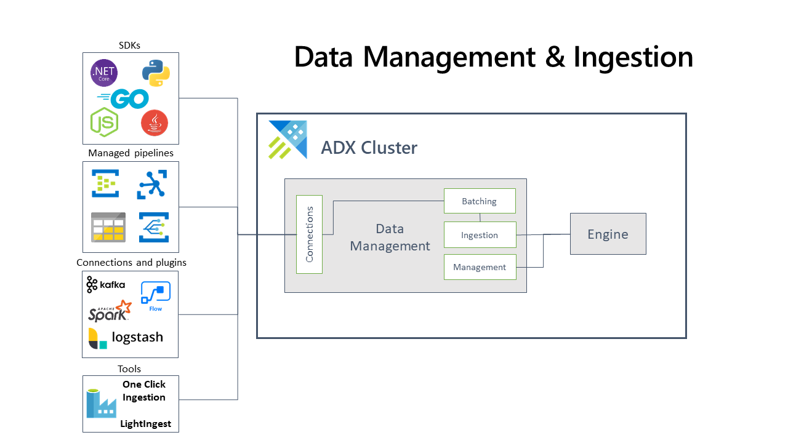
Data Management and Ingestion
SDKs
Managed pipelines
ADX Cluster
Connections
Batching
Engine
Connections & plugins
Ingestion
Data Management
Management
Tools
Notes:
Azure Data Explorer pulls data from an external source and reads requests from a pending Azure queue. Data is batched or streamed to the Data Manager. Batch data flowing to the same database and table is optimized for ingestion throughput. Azure Data Explorer validates initial data and converts data formats where necessary. Further data manipulation includes matching schema, organizing, indexing, encoding, and compressing the data. Data is persisted in storage according to the set retention policy. The Data Manager then commits the data ingest to the engine, where it's available for query.

Slide 25

One-Click Ingestion (wizard) Friction free on-boarding of your Azure data sources to Azure Data Explorer
Get data from Azure Data Lake, Blob, Event Hub, or local file
Infer the schema automatically from source
Create table and mapping
Ingest one-time data or create connection for continuous data ingestion
Continuous, one time or backfill
IoT Hub
Azure Data Explorer
Event Hubs
Azure Data Lake Storage

Slide 26
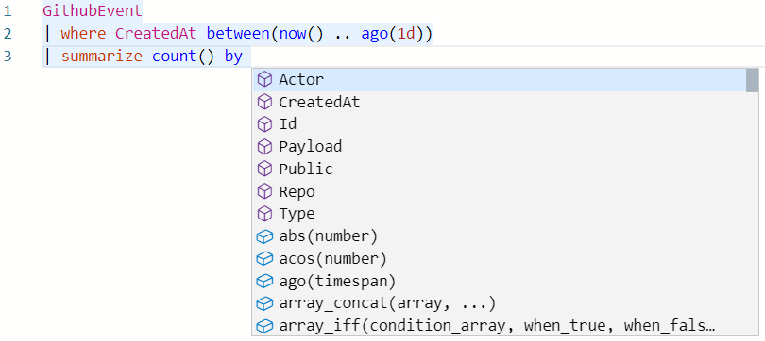
Intuitive querying
Simple and powerful
Rich rational query language (filter, aggregate, join, calculated columns, and more)
Built-in full-text search, time series, user analytics, geospatial, and machine learning operators
Out-of-the box visualization
Easy-to-use syntax + Microsoft IntelliSense
Highly recognizable hierarchical schema entities
Extensible
In-line Python and R
T-SQL

Slide 27
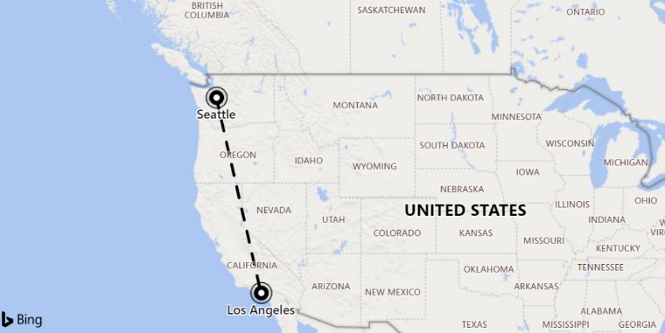
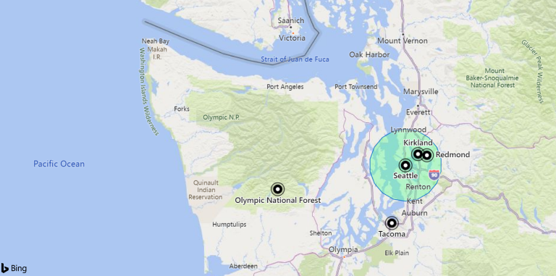
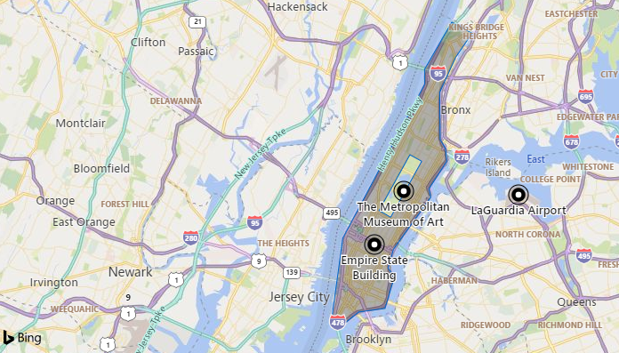
Geospatial query
Geohash support
Transformation from coordinates to geohashes and back
Use-case: Summarization by geographical buckets, store locations based on a single column
Distance
Calculate the distance between two points
Contains
Check whether a point is in a given circle
Next: support for lines & polygons (i.e. check whether a point/line/polygon is in a polygon)
Next: Intersection
Support for lines & polygons
Geospatial coordinates are interpreted as represented per the WGS-84 reference system.
Notes:
Geohash
https://docs.microsoft.com/en-us/azure/kusto/query/geo-point-to-geohash-function
https://docs.microsoft.com/en-us/azure/kusto/query/geo-geohash-to-central-point-function
Points in circle
https://docs.microsoft.com/en-us/azure/kusto/query/geo-point-in-circle-function
Distance
https://docs.microsoft.com/en-us/azure/kusto/query/geo-distance-2points-function

Slide 28
Advanced Analytics – Built-in & Extendible
Out of the box
Auto Clustering for Diagnosis and RCA
Anomaly Detection
Regression
Forecasting
Time Series Analysis library
Distributed Custom Code Execution
Distributed Python and R execution
Custom code is embedded in the KQL query
Spark Integration
Native Spark connector for heavy duty model training
Operationalize model into ADX for scoring
Tools
Jupyter Integration with KQL Magic
Python, Java SDKs

Slide 29
ADX for Data Scientists

Slide 30
Agenda
Time Series Analysis for Anomaly Detection, Forecasting
Clustering plugins for Diagnosis of Anomalies & RCA
SCAN operator for Process Mining and Sequence Analysis
KQL extensibility with inline Python/R
Connectivity with Python, R, Jupyter/Azure Notebooks, Spark

Slide 31
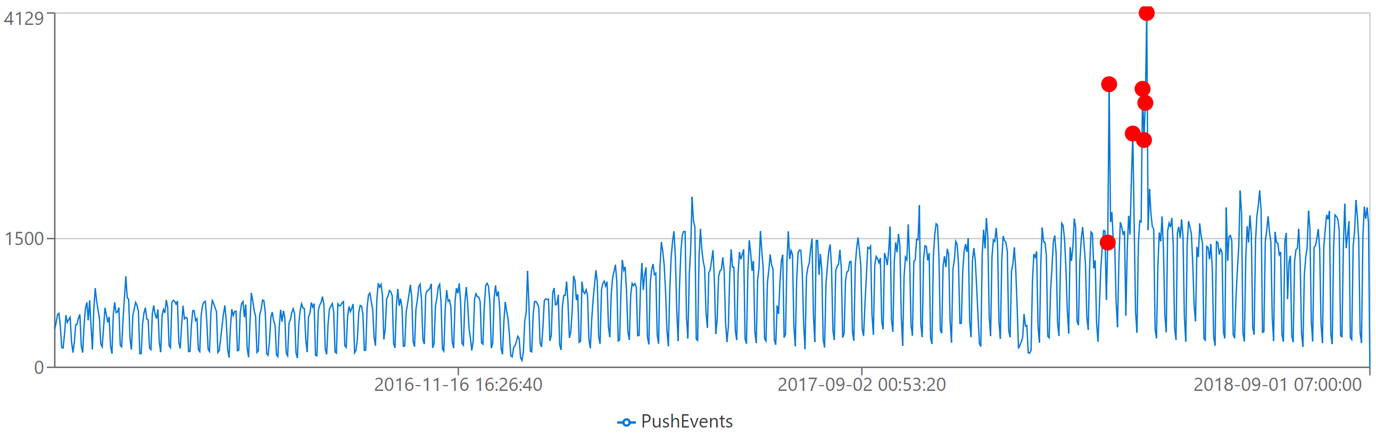
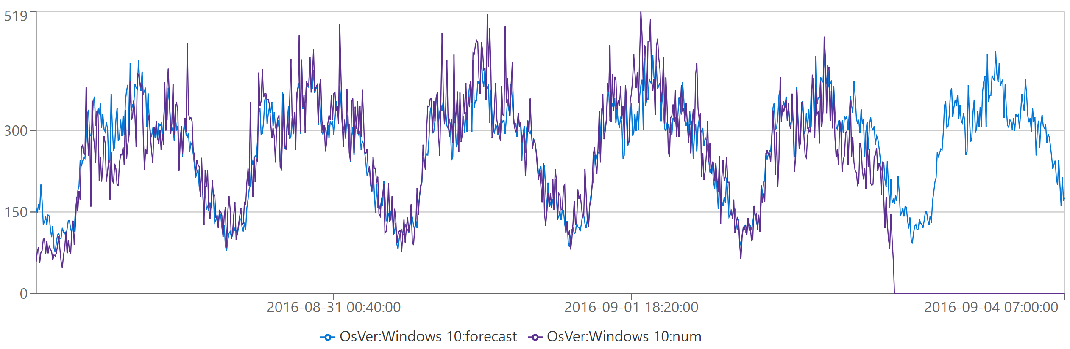
Time Series Analysis
Demo
T | make-series operator for creating set of (time) series
Large family of functions can be applied on set of time series:
Element-wise operations
Filtering (signal processing)
Statistics
Regressions
Seasonality detection/validation
Anomaly Detection
Forecasting
mv-apply operator
Series functions are optimized for bulks of time series

Slide 32
Machine Learning Plugins
Demo
Data Mining on multiple dimensions for diagnosis, RCA and more
autocluster: clustering a single records set
basket: same, using apriori algorithm
diffpatterns: clustering differences between two records sets
diffpatterns_text: tokenize text column and run diffpatterns

Slide 33
Process Mining by the SCAN operator
Demo
The user defines a process model composed of sequential states and transition rules from the first to the last state
The operator scans the data and extracts the instances (each one is an events sequence) conforming to that process model
Can be used for
Process Mining
User analytics, funnel analysis
Recursive calculations
Additional temporal analytics scenarios

Slide 34
python plugin: KQL extensibility with inline Python
Demo
Python engine run on secure local containers on the same Kusto compute nodes
Image is based on Anaconda 5.2.0 + popular packages (tensorflow, keras, torch and more)
Execution on single node (default) or distributed processing
Ability to install custom packages
Support for scoring with big ML models
Editing & Debugging with VS Code (client-side integration)

Slide 35
ML Connectivity
Demo
Jupyter/Azure Notebooks with KqlMagic extension
Connect multiple clusters (Kusto, Log Analytics, App Insights)
Create rich interactive notebook with Kusto and Python
Use out-of-the-box integration with Python visualization libraries

Slide 36
ML Connectivity
Python & R Client SDKs
Access data from Kusto using Python or R libraries
Spark connector
Read data or write data to Kusto using Scala and PySpark
Parquet support
Ingest parquet files from Blob/Data Lake
Export data to Blob/Data Lake as parquet files (with partitioning support)
External tables
Query parquet files from data lake as external

Slide 37
ADX “other” Topics

Slide 38

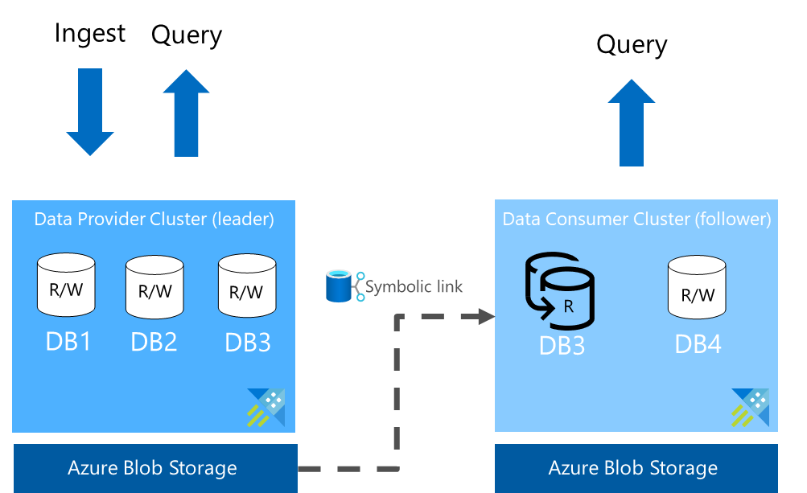
Azure Data Share - Data Sharing
Share data within the company
Load balancing
Ring fencing
Data-as-a-service
Chargeback
Share data with partners
Data sharing in near-real-time
In-Place Data Sharing
No data pipeline to maintain
Near-real-time updates
Share data with customers
Data sharing in near-real-time
Extend your business model
Notes:
Data Share integration enables sharing data:
Within the company
Across companies – tenants
Optimize my business
Typical Use Cases
Data providers can use this integration to share their data with their customers in a simple and secure way. Example, a weather forecast provider can share their data in near-real-time with their customer without having them to maintain the data pipeline. As the data is updated on the leader cluster, the change will appear on the follower cluster in few seconds or minutes depending the data volume and metadata.
Organizations can share their data with partners for collaboration and data exchange. For example, a retail company sharing the data with their suppliers.
Share data within the company or provide data-as-a-service. Many organizations would like to share the data within the company and have individual teams accountable for their usage and cost. With Azure Data Explorer, every team could have their cluster with their choice of configuration and sharing the same data from one leader cluster.

Slide 39


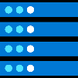



Pricing – Flexible Cost
Reserved resources cost model
Dedicated capacity
Reserved instance pricing available
Advantages of this model
Freely explore your data - not bound by cost per query
Predictable cost
Decoupled storage and compute
Easy to switch between SKUs after provisioning
Ability to Start/Stop the compute
Four main components
Compute Hourly billing
Storage & Transactions Used for persistent store, compressed data (typical 6x compression)
Network
Markup/IP Cost of using the PaaS Service – hourly billing based on the compute usage
http://aka.ms/adx.cost
Wide range of options
CPU optimized and Storage optimized SKUs Dev/Test SKU under $200/month PROD SKUs starting around $600/month

Slide 40

Enterprise Ready – Mission Critical
Azure Active Directory Integration
Availability Zones
Role based authorization
Auto Scale-Up/In
Network Perimeter Security
Globally available
Encryption with customer managed keys/”BYOK”
CI/CD Integration
Build Azure Policy Support
Automated provisioning
Bring Your Own Keys
Monitoring
Notes:
Azure Data Explorer is enterprise ready will all the key capabilities you need get to production.

Slide 41
Product Links
Product
Product Page: http://aka.ms/AzureDataExplorer
Docs: https://aka.ms/adx.docs
Cost Estimator: http://aka.ms/adx.cost
Free online Courses:
KQL from Scratch, Azure data exploring, How to start with Azure Data Explorer (blog), Advanced KQL (blog)
Lab: https://aka.ms/adx.lab
Whitepaper: https://azure.microsoft.com/en-us/resources/azure-data-explorer/en-us/
101 blog: https://azure.microsoft.com/en-us/blog/azure-data-explorer-technology-101/
Trial Cluster - http://aka.ms/adx.try
Reference Architectures - https://aka.ms/adx.architectures
Social and Community
Twitter: @AzDataExplorer
Tech Community Blog: https://aka.ms/adx.blog
Tech Community Forum: http://aka.ms/adx.techcommunity
Stack overflow: https://aka.ms/adx.sof
YouTube Channel: https://aka.ms/adx.youtube

Slide 42

Thank you!

Slide 43

ADX - The platform for Analytical SaaS
Customer Need | Azure Monitor | Azure Security * | Industrial IoT - Time Series Insights - | Xbox Playfab | MCVP
A fit for purpose end to end solution. | Lead with Azure Monitor Log Analytics and Application insights when the customer needs an E2E solution for IT infrastructure, services and applications monitoring and analytics. App and infra monitoring models and knowledge OOB Full multitenant monitoring experience with alert, dashboards Smart analytics for monitoring Solution framework for specific more knowledge domains Powerful analytics capabilities of KQL over time series and telemetry data | Lead with the Microsoft security solutions like Windows Defender Advanced Threat protection, Azure Security Center and azure Security Insights when the customer needs a security solution Security knowledge applied out of the box Automatic remediation, protection Powerful analytics capabilities of KQL over time series and telemetry data | Lead with TSI when the customer needs an end-end-end solution for Industrial IoT analytics that offers: IoT-optimized, turnkey, PAYG, serverless platform Rich semantic modeling for contextualization of time series data Asset-based analytics user experience for discovery, trending, anomaly detection and operational intelligence | Lead with Playfab when the customer needs full platform for game development including game analytics and data exchange | Lead with MCVP for connected cars E2E fit for purpose solution and platform
A flexible platform to build custom analytical solutions. | Recommend ADX when the customer is building their own analytics solution or platform and needs: Full control of data sources, data schema and data management Powerful analytics capabilities of KQL over time series and telemetry data Reserved resources cost model

